Slide 1



Nanofabrication Using Self-Assembled Monolayers
Madison Driskill, Adam Hinckley, Anthony Muscat
Department of Chemical and Environmental Engineering
The University of Arizona, Tucson, AZ
NASA Space Grant Symposium
Tempe, AZ
April 13, 2019

Slide 2
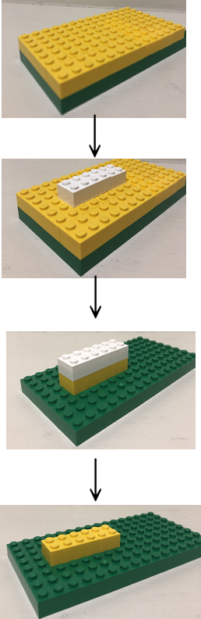
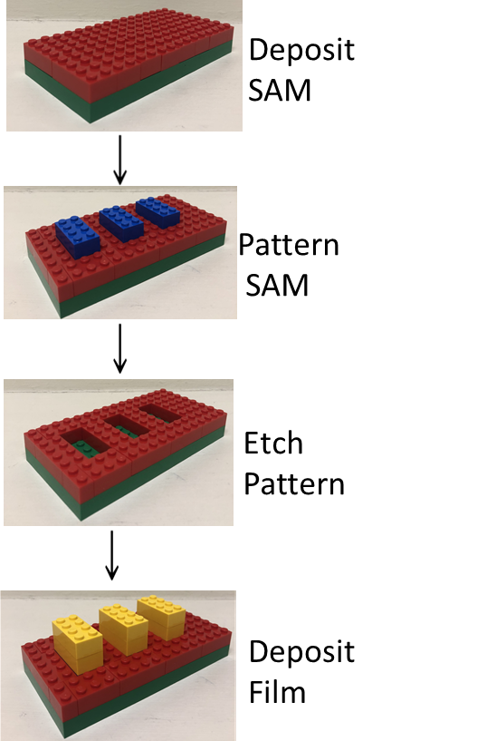

Microelectronic Device Fabrication Processes
Subtractive
Additive
Subtractive Methods:
  used to build structures in devices
  costly because they require large
  amounts of materials, water, and
  energy
Additive makes more efficient use of materials, water, and energy.
  Area-selective deposition (ASD)
Self-assembled monolayers (SAMs) can be used with ASD.
SAMs function as a mask on the surface and pattern can be reused.
Deposit
ALD Film
Deposit
Photoresist
and Pattern
Etch Film
to Transfer
Pattern
Strip
Resist

Slide 3


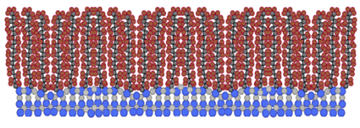
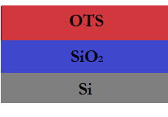

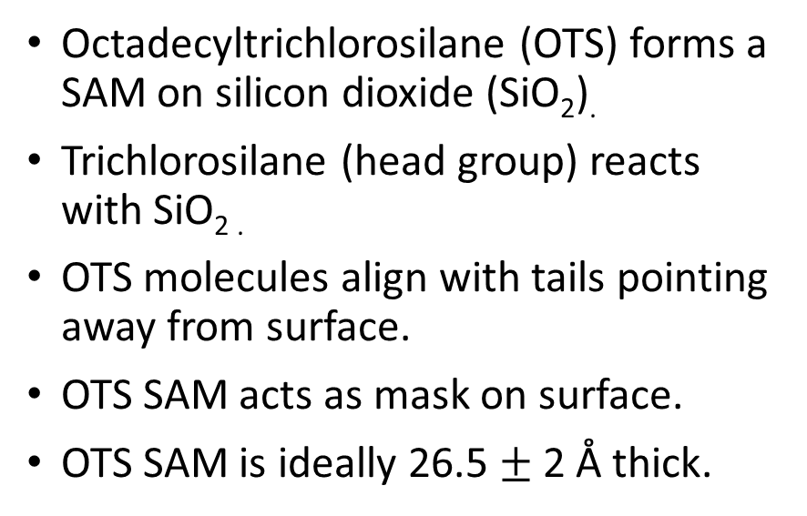

Self-Assembled Monolayers (SAM) Deposition
$$←$$
Hydrocarbon tail (octadecyl)
Octadecyltrichlorosilane (OTS) forms a SAM on silicon dioxide (SiO₂).
Trichlorosilane (head group) reacts with SiO_{2 .}
OTS molecules align with tails pointing away from surface.
OTS SAM acts as mask on surface.
OTS SAM is ideally 26.5 $±$ 2 Å thick.
Trichlorosilane (head group)
Peters, R. D.; Nealey, P. F.; Crain, J. N.; Himpsel, F. J. Langmuir 2002, 18, 1250-1256.

Slide 4
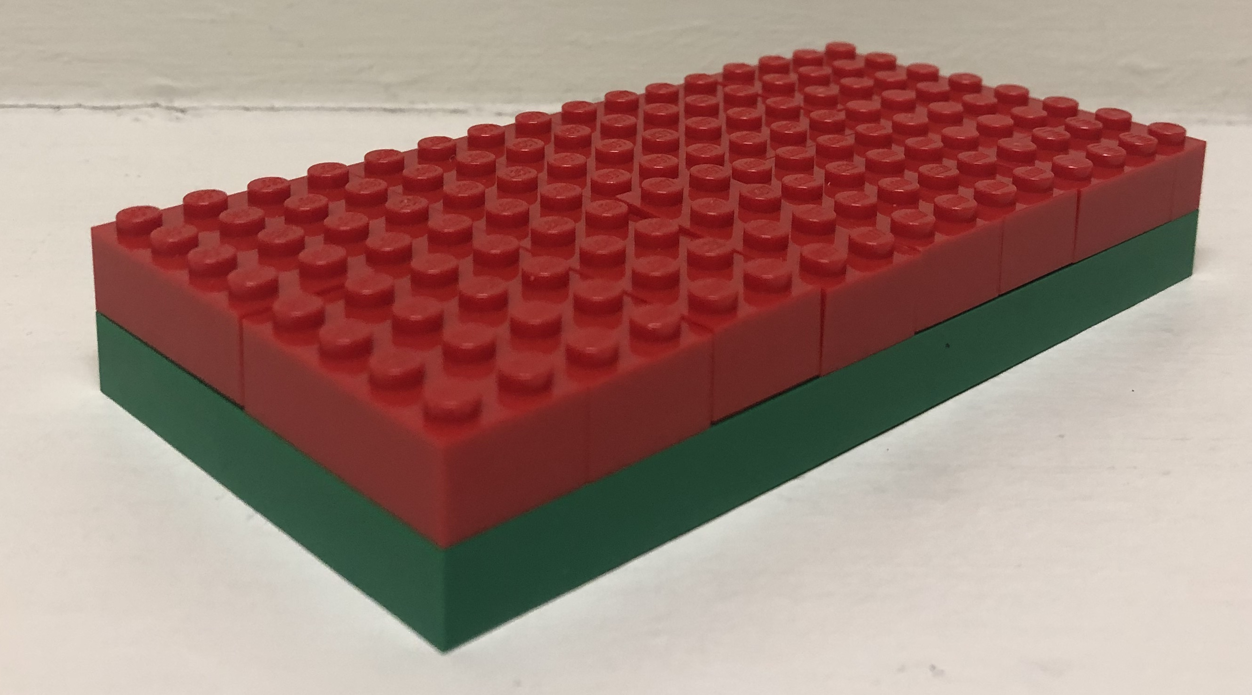
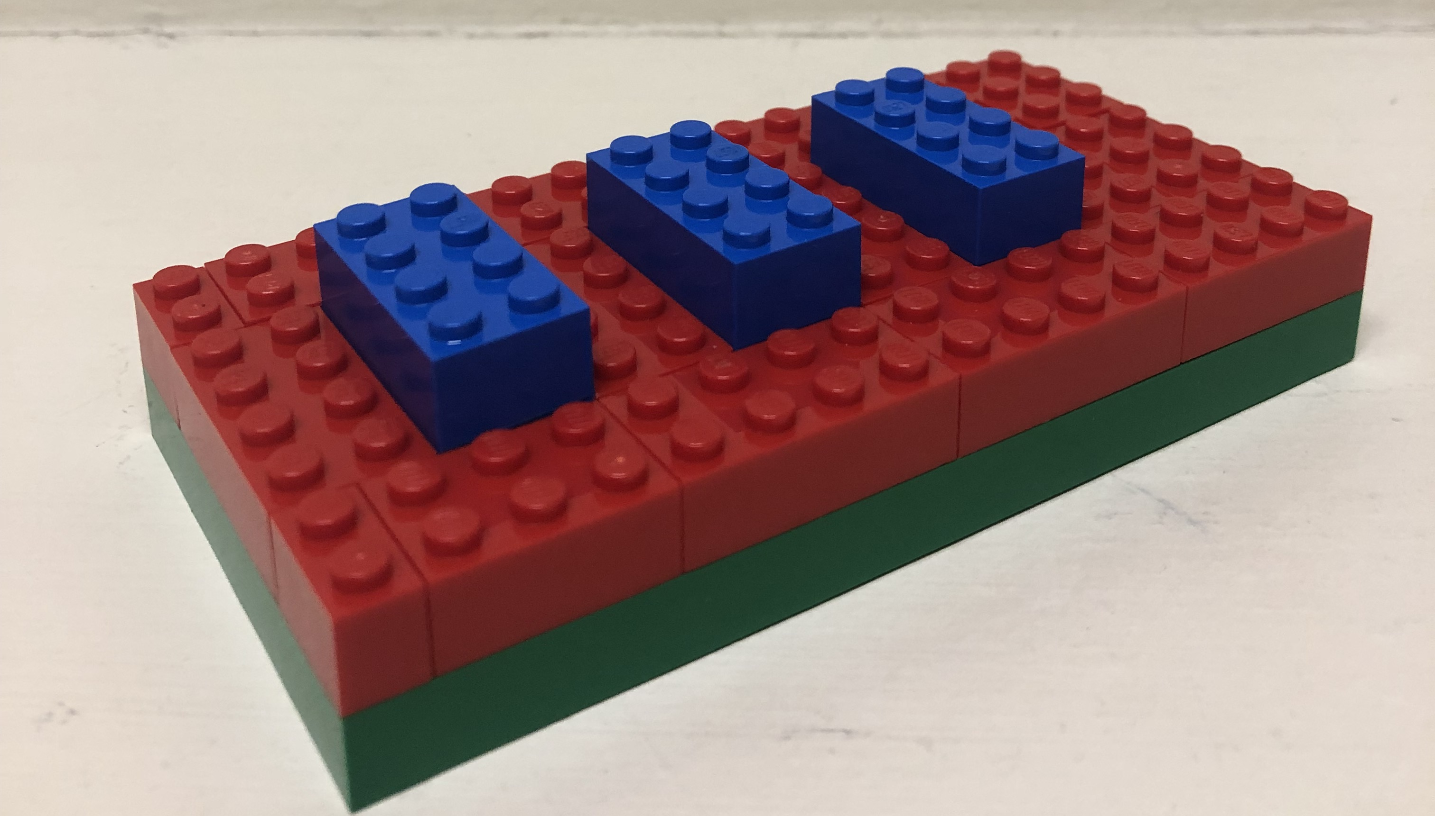
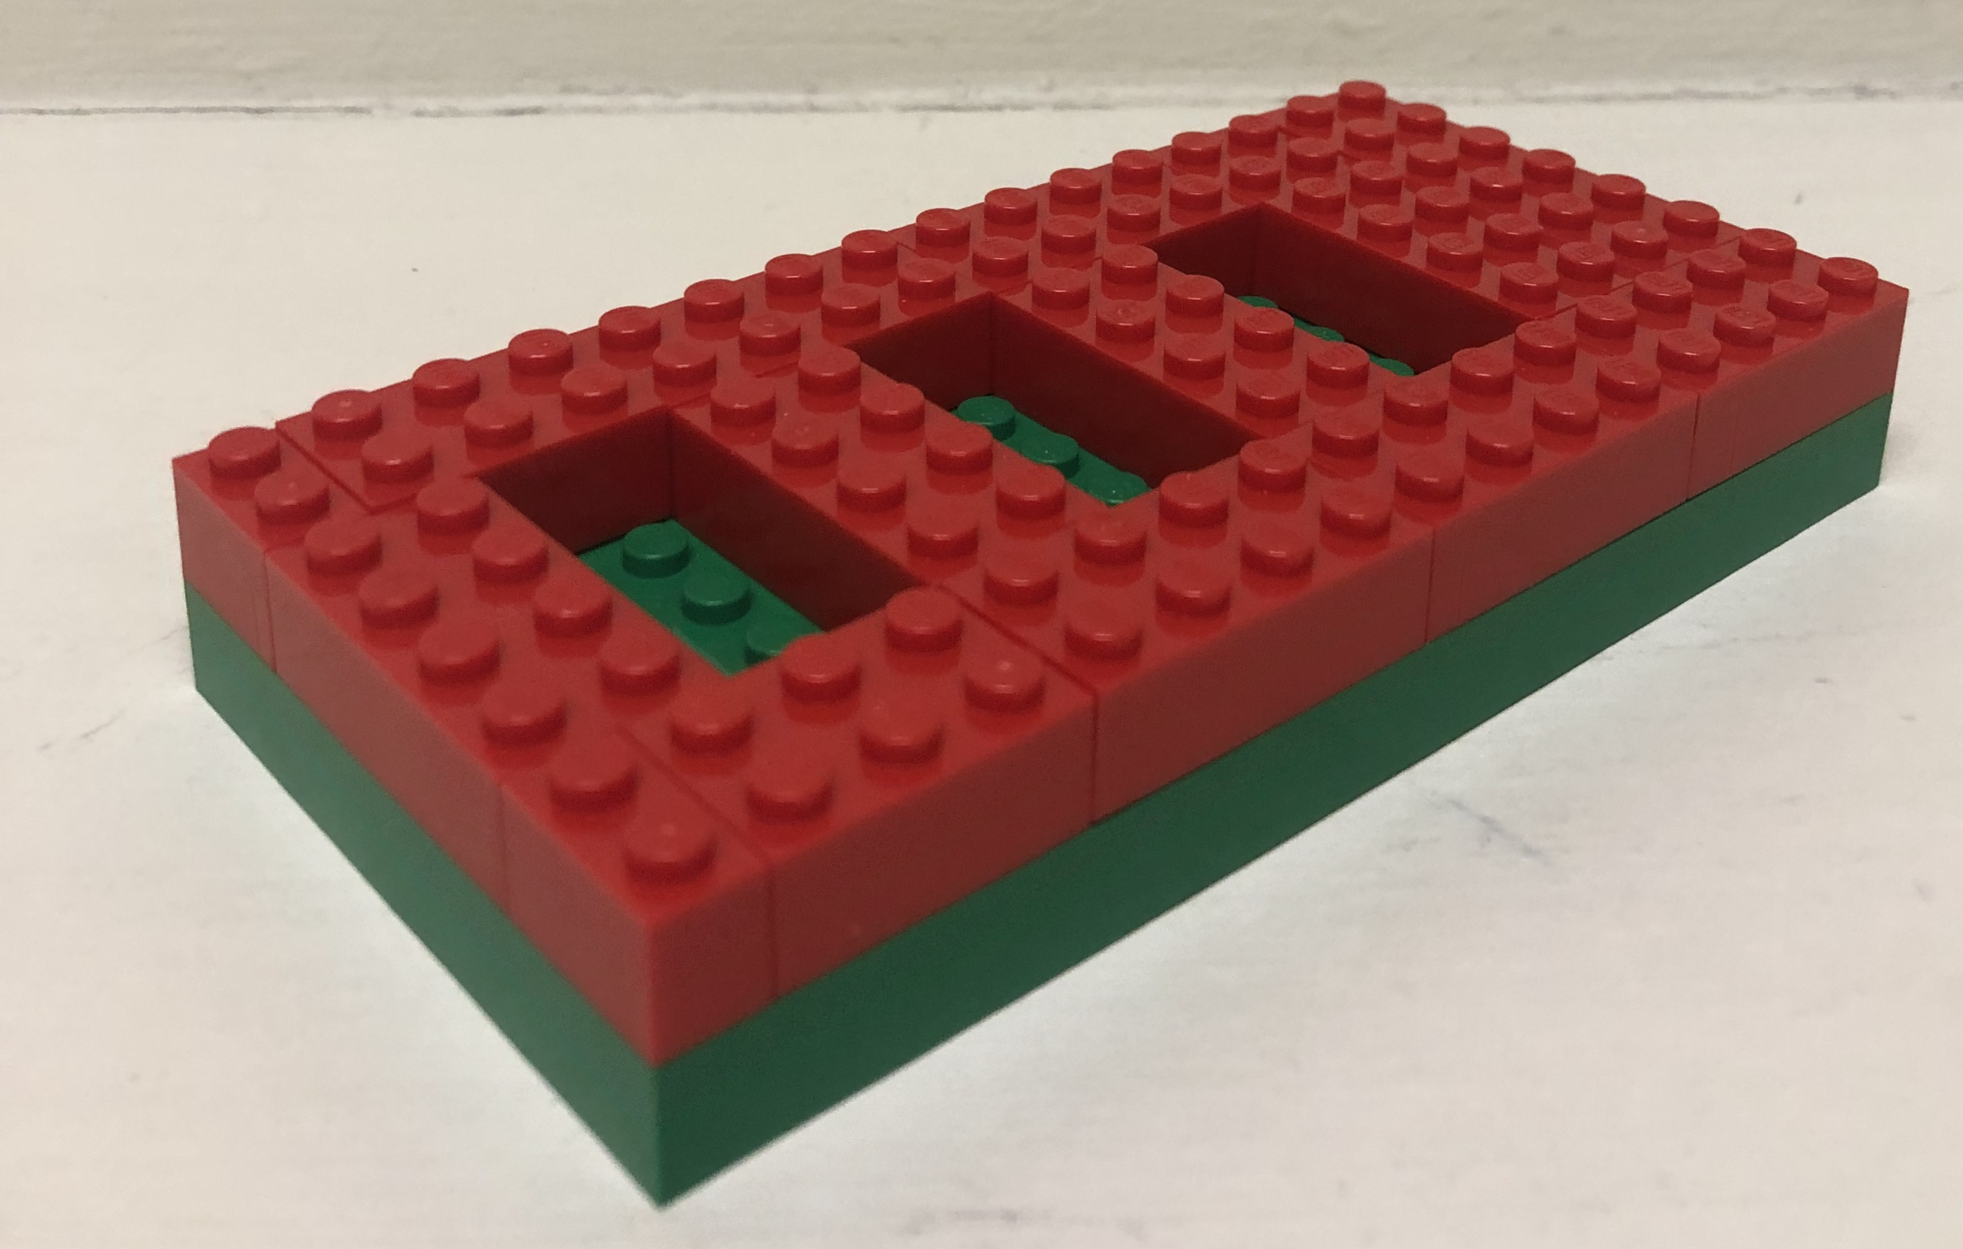
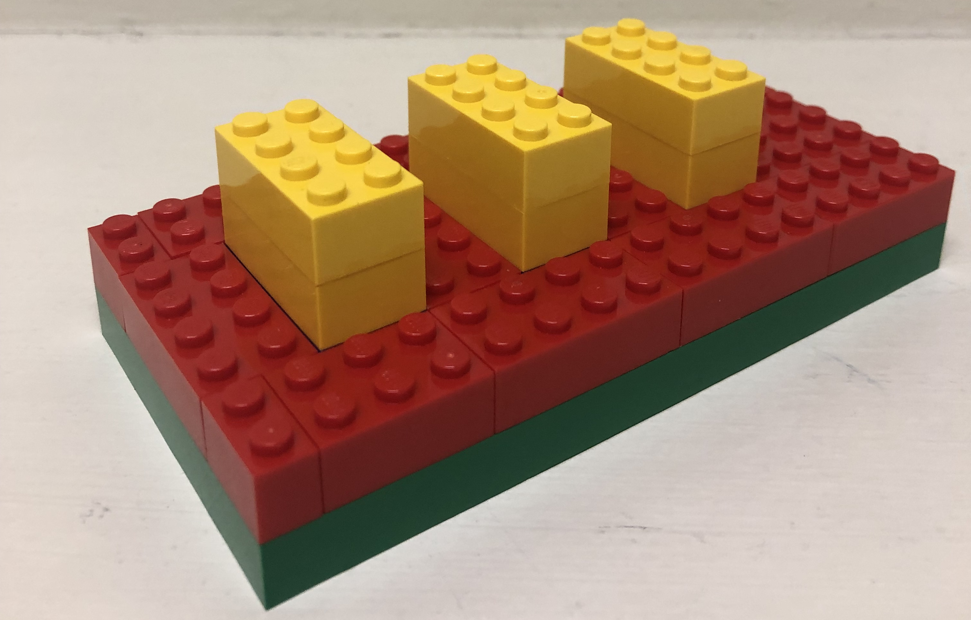
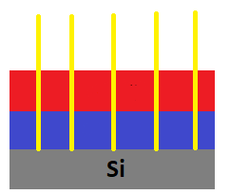
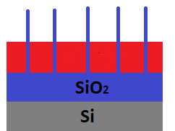
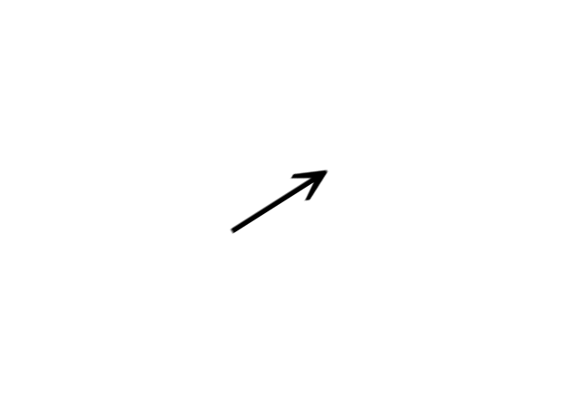



Area-Selective Deposition of Titanium Dioxide
Hypothesis: If an OTS SAM is deposited on SiO₂ and patterned using conductive AFM, TiO₂ will selectively deposit within the pattern.
Titanium Dioxide (TiO₂) is used in sensors.
AFM
Patterned
HF
Etched
ALD
of TiO₂

Slide 5
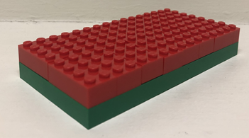
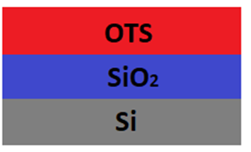
Atomic Force Microscopy (AFM) Imaged OTS SAM
Ellipsometry measurements indicate presence of OTS SAM.
Surface roughness is 0.15 nm which is close to that of silicon dioxide (0.2 nm).
Ellipsometry Measurements

Slide 6
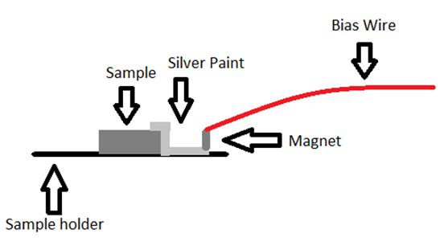
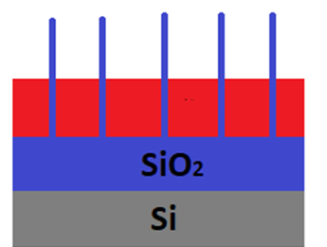
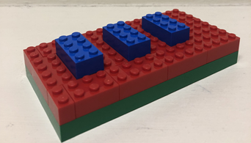
Nanolithography and Conductive AFM
Conductive AFM (CAFM) uses current through sample and cantilever to pattern SAM.
Local anodic oxidation (LAO) from applied voltage desorbs monolayer and grows SiO_{2.}
Fabre, Bruno & Herrier, Cyril. (2011). Automated sub-100 nm local anodic oxidation (LAO)-directed nanopatterning of organic monolayer-modified silicon surfaces. Rsc Advances. 2. 168-175.

Slide 7
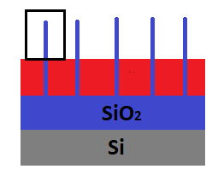
Patterned OTS SAM
SiO₂ lines grown by applying a voltage through the sample and the reaction with the ambient water vapor.
Total height of SiO₂ lines: 3.5 nm
Line Width: 175 nm

Slide 8
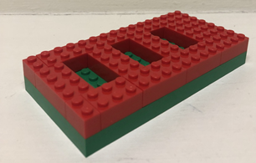
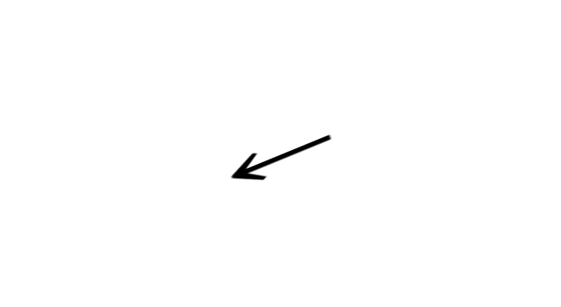
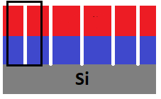
HF Etched Patterned OTS SAM
SiO₂ lines selectively etched in aqueous 1:100 HF for 60 seconds.
Troughs created in sample from etching in HF.
No change in thickness of OTS SAM verified by ellipsometry.
OTS functioned as a mask.

Slide 9
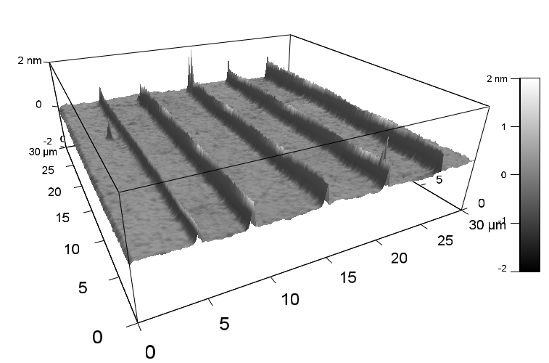
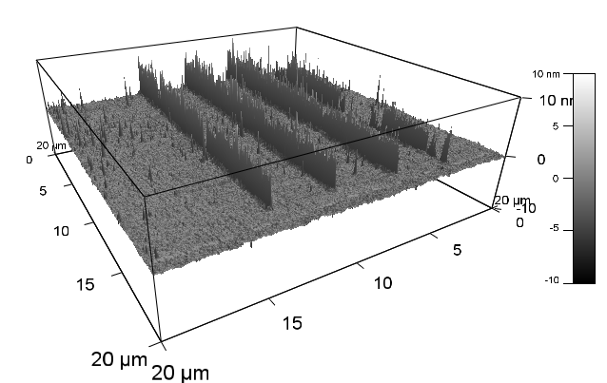
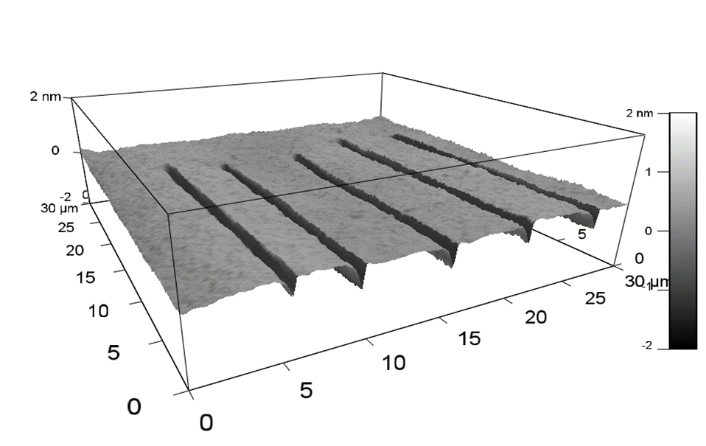
Three-Dimensional Images of Sample at Each Process Step
Patterned OTS SAM
OTS SAM After TiO₂
Patterned OTS SAM After HF

Slide 10


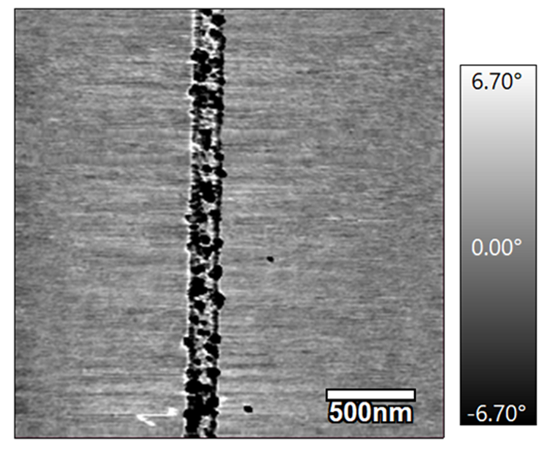
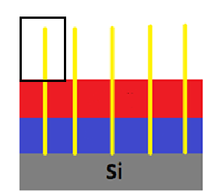
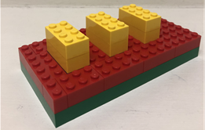
TiO₂ Area-Selectively Deposited From ALD
TiO₂ selectively deposited into troughs.
-200 ALD cycles of TiCl₄ and H₂O
10.1 nm total of TiO₂ selectively deposited into troughs.
All troughs resemble segment.
Phase image shows differences in composition.

Slide 11


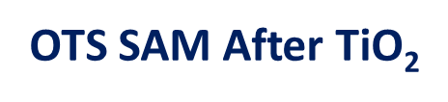

TiO₂ ASD From ALD: Line Widths
SiO₂ line width: 169 ± 8 nm
Trough width: 180 ± 8 nm
TiO₂ line width: 176 ± 10 nm
95% Confidence Intervals
Notes:
$$±$$

Slide 12
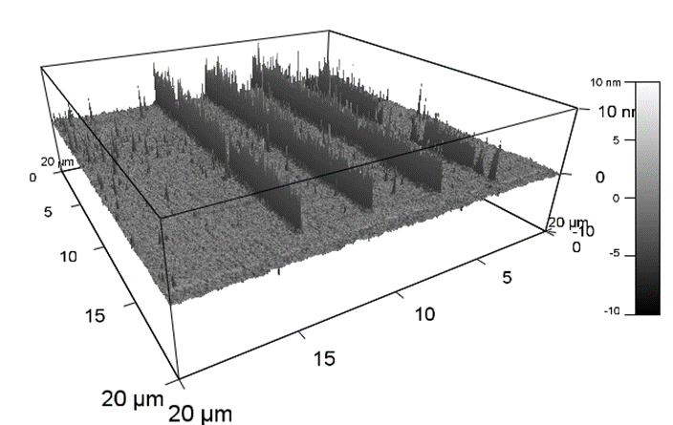

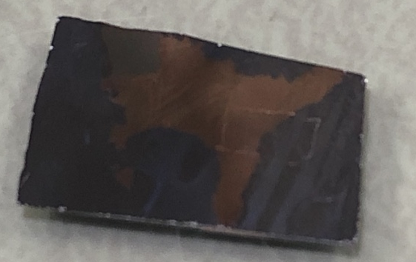
Conclusions
TiO₂ was selectively deposited into the troughs on the OTS SAM as verified by AFM imaging.
  OTS SAMs were deposited onto SiO₂ and patterned with CAFM.
  OTS SAMs are resistant to dilute, aqueous HF as seen with ellipsometry.
  Aqueous HF was used to etch the patterned SiO₂ lines.
  OTS SAM was successfully used as a mask.
ASD of other metals such as copper or palladium
New patterning techniques to reduce line size such as scanning electron microscopy (SEM) or electron beam lithography (EBL)
Future Work

Slide 13


Acknowledgements
Adam Hinckley
Dr. Anthony Muscat
Muscat Research Group
NASA/Arizona Space Grant Consortium

Slide 14
Thank You

